Slide 1
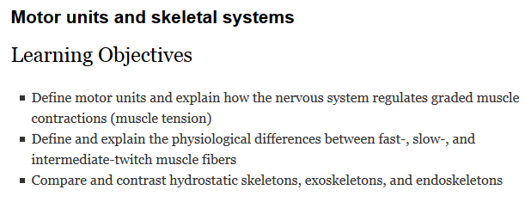
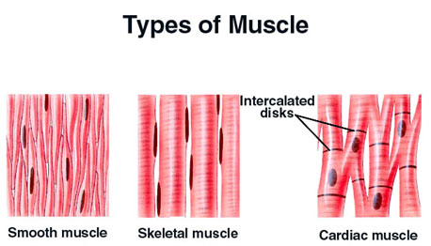
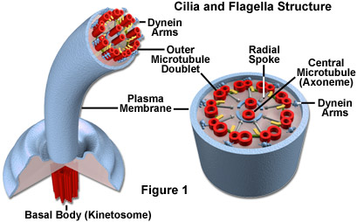
Effectors & Movement II

Slide 2
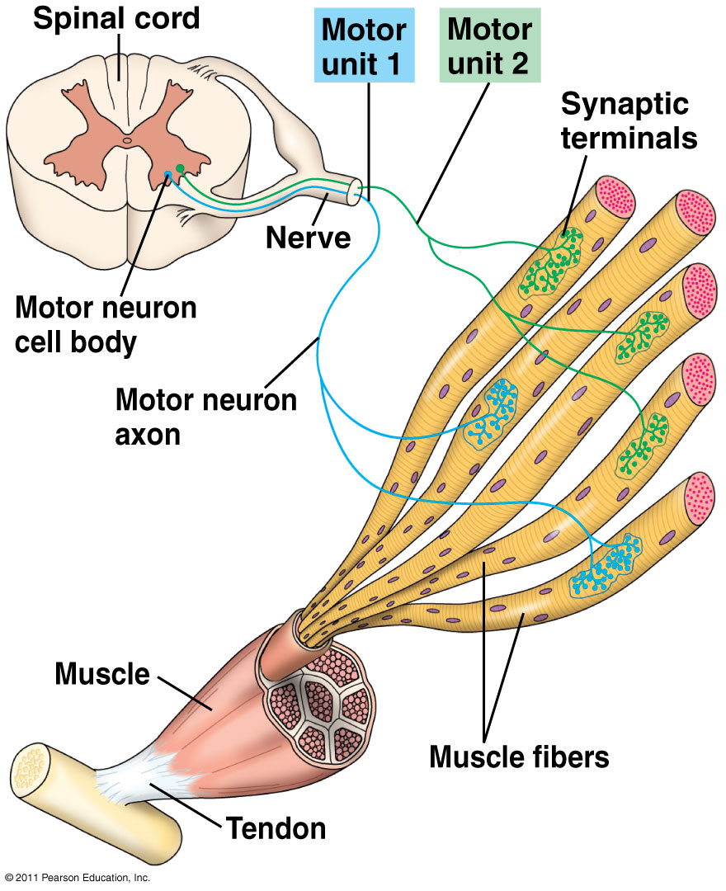
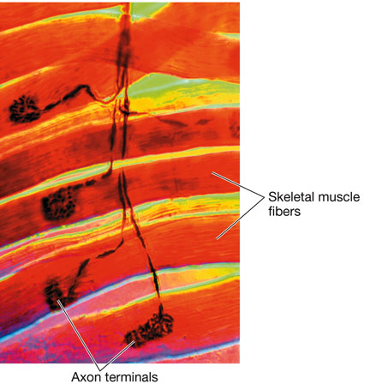
Two basic mechanisms for grading muscle contractions
Motor unit = a single neuron + all the muscle fibers it enervates (controls)
Vary the number of fibers (cells) that contract

Slide 3
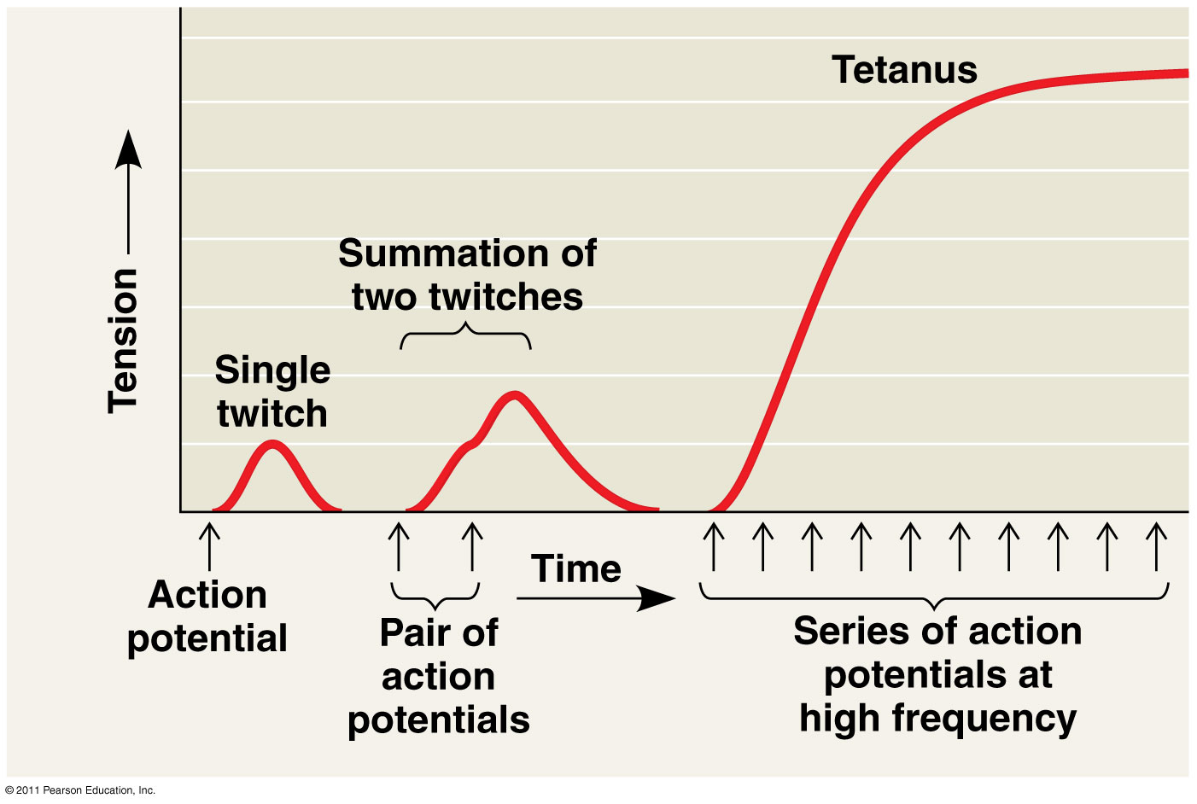
Two basic mechanisms for grading muscle contractions
Vary the rate at which fibers are stimulated
Tetanus = maximum contraction possible
A twitch results from a single action potential in a motor neuron
More rapidly delivered action potentials produce a graded contraction by summation

Slide 4
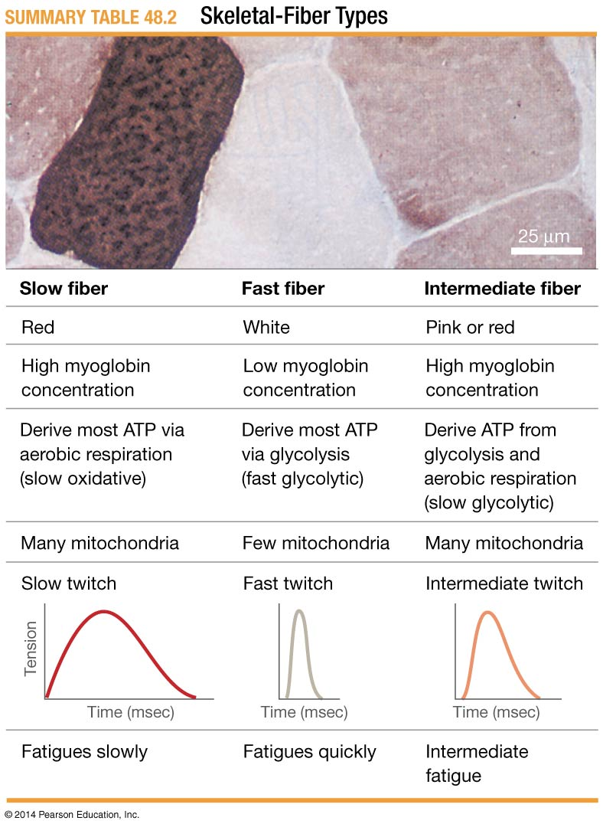
Types of skeletal muscle fibers (cells)
Oxidative –oxidative phosphorylation generates ATP (slow)
Glycolytic – glycolysis generates ATP (fast)
Fast-twitch – brief, rapid, powerful contractions
Glycolytic (fewer mitochondria)
Rapid release and uptake of Ca2+
Appear white due to low myoglobin conc.
Quick to fatigue; specialized for bursts of activity
Slow-twitch – long contractions
Oxidative (many mitochondria)
Slower release and uptake of Ca2+
Appear red due to high myoglobin conc.
Slow to fatigue; specialized for endurance
Intermediate – varying contractile properties
Mixture of oxidative and glycolytic
Appear pink to red
Most skeletal muscle contains both slow- and fast-twitch fibers in varying ratios
Notes:
Memorize chart

Slide 5
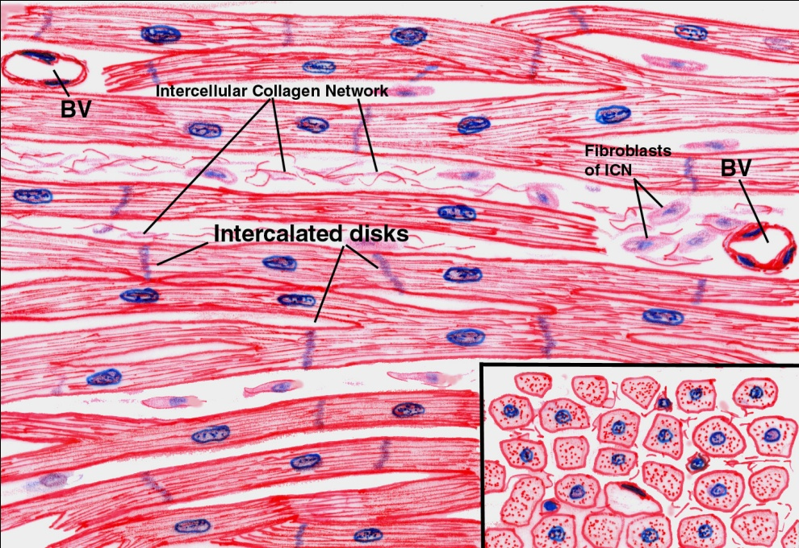
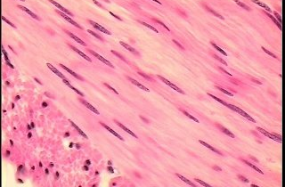
Other types of muscle
Cardiac muscle
Smooth muscle
Don’t require neural input for contraction (relies on pacemaker cells)
When it does occur, neural input is from what part of the nervous system?
Notes:
Autonomic nervous system stimulate smooth and cardiac muscle

Slide 6
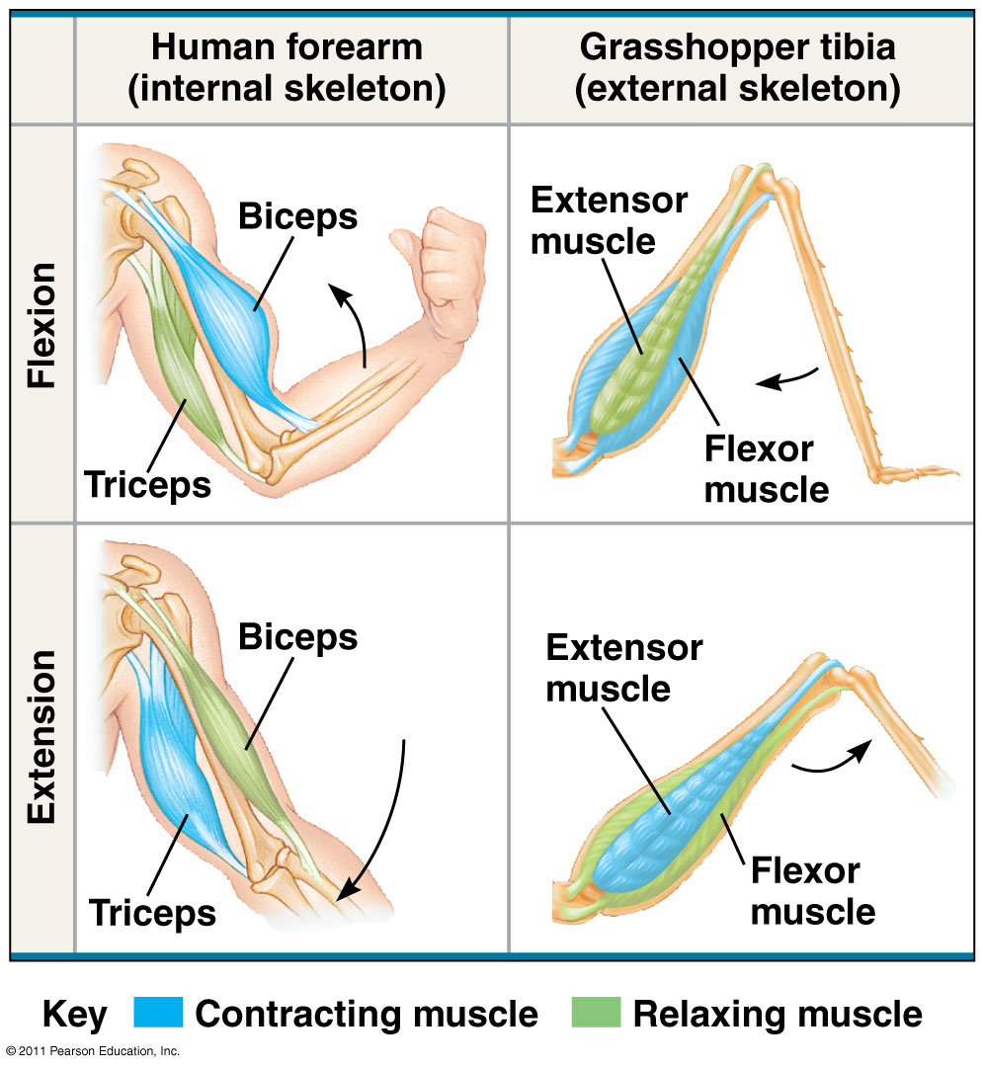
Antagonistic muscles function cooperatively
Flexor brings two bones in an arc toward each other
Extensor straightens them out

Slide 7
Skeletal systems
A hydrostatic skeleton consists of fluid held under pressure in a closed body compartment
This is the main type of skeleton in most cnidarians, flatworms, nematodes, and annelids
An exoskeleton is a hard encasement deposited on the surface of an animal
Exoskeletons are found in most mollusks and arthropods
The polysaccharide chitin is often found in arthropod cuticle
An endoskeleton consists of hard supporting elements, such as bones, buried in soft tissue
Endoskeletons are found in sponges, echinoderms, and chordates
A mammalian skeleton has more than 200 bones
Some bones are fused; others are connected at joints by ligaments that allow freedom of movement

Slide 8
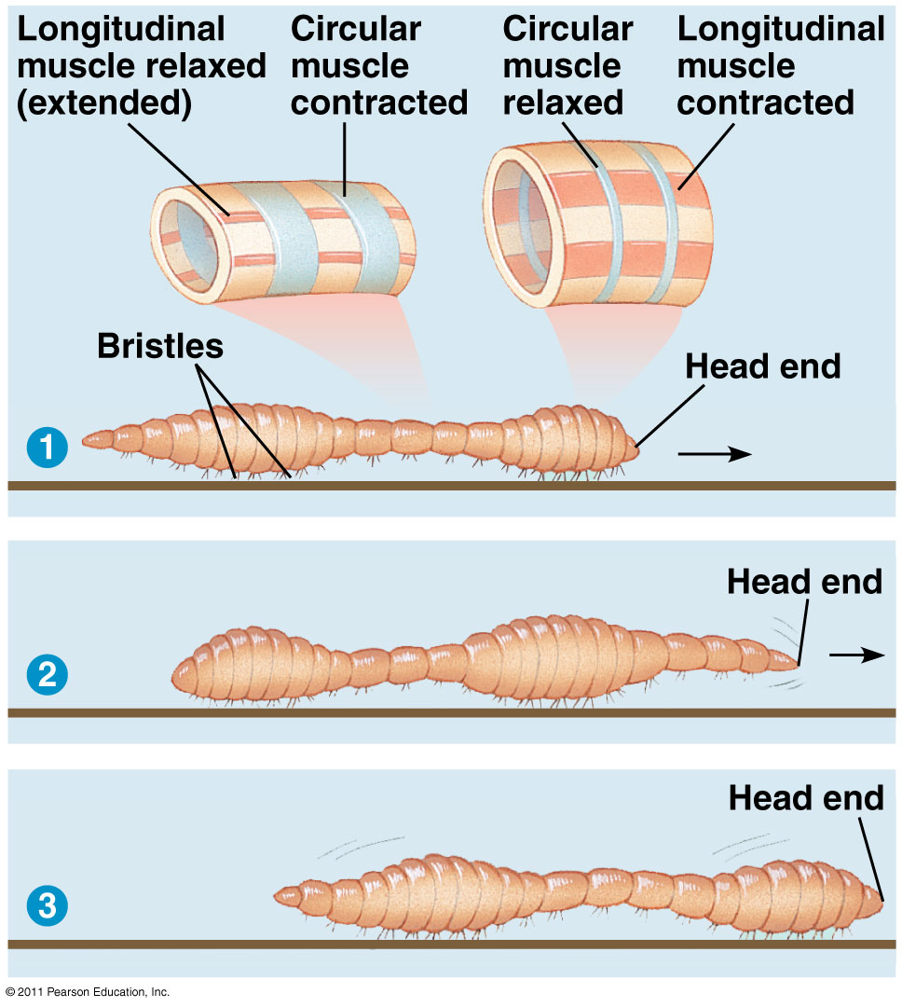

Slide 9
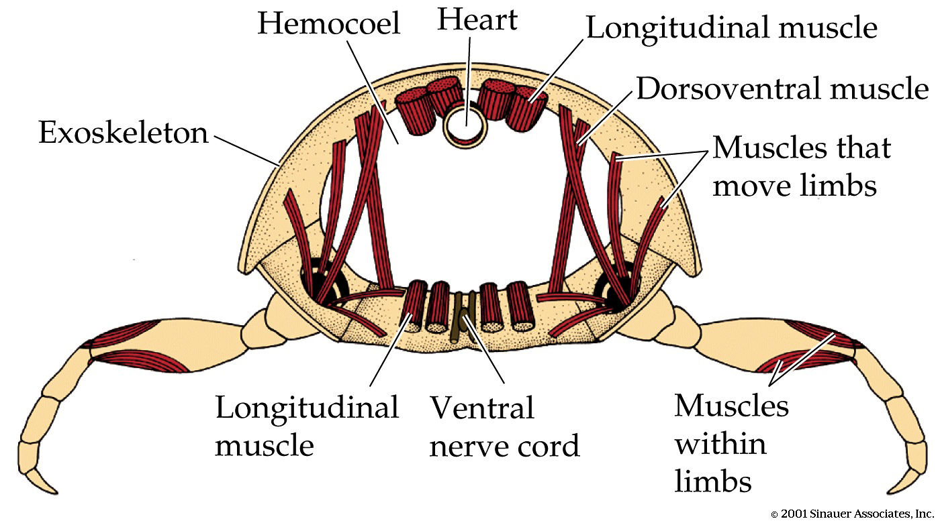
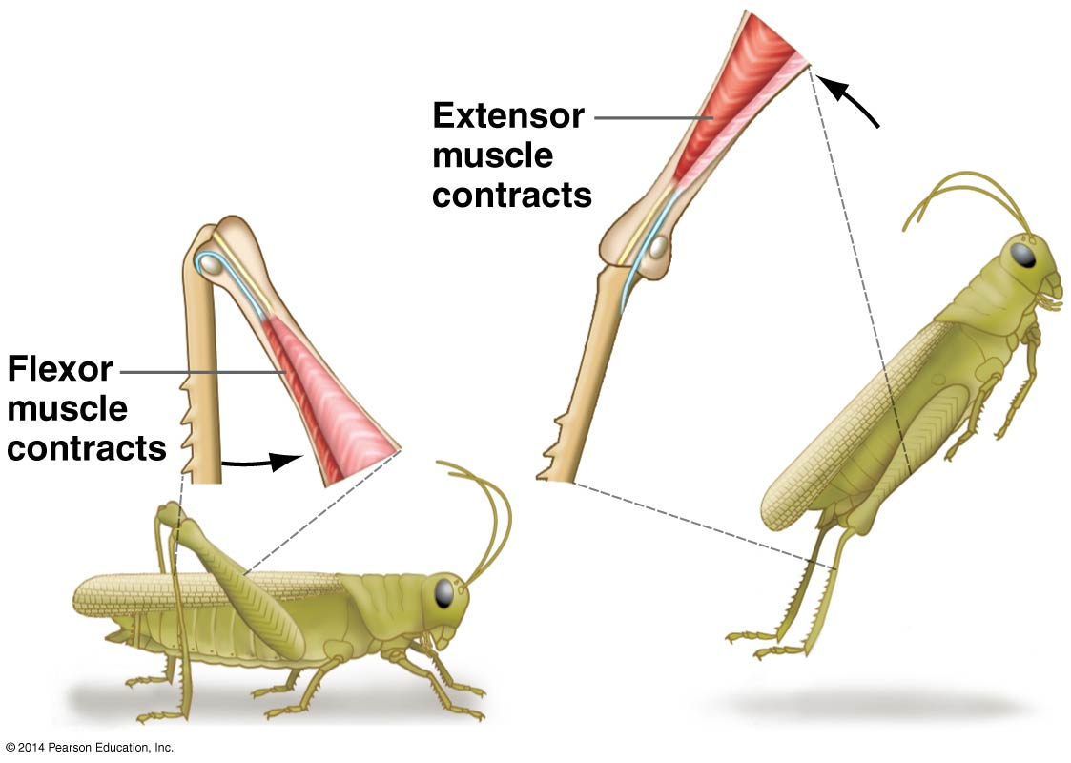
“The mobile box of armor”
Note differences in contraction width

Slide 10
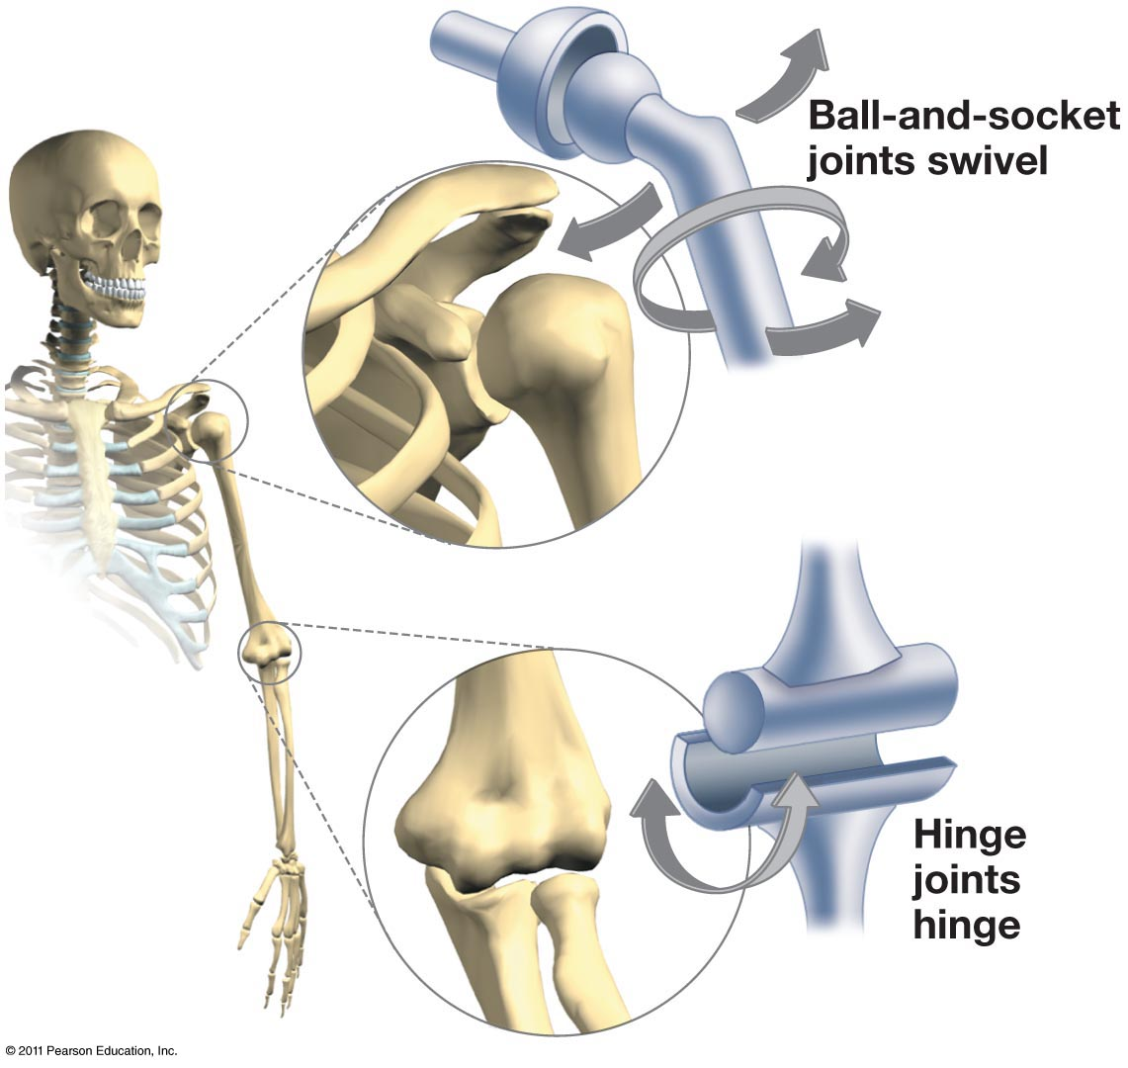
Endoskeletons

